Slide 1

The characterization and application of network resilience under financial crisis
Jingyi Liao, Yuan Cui, Yixi Li
Date: 18/12/2018

Slide 2

1. Background
Finacial behavior of companies
Complex network
Finaicial failure
Recovery form disruption
Self- recovery
Resilliance
Notes:
In today’s hyper-competitive financial market environment, sustainable financial situations such as turnovers and cash flows are essential for company to survive. Financial failures, however, have potential to destroy not only the company but also the whole industrial ecosystem. Moreover, Recent industry examples highlight the challenges that companies face in recovering from a disruption. For instance, Toyota had a supply network disruption in the aftermath of the 2011 tsunami in Japan. This poses challenges to the companies’ reaction towards the crisis. Resilience, an indicator of the capacity to undergo deep change without or prior to a crisis, has been widely used as a parameter to examine the ability to stabilize within a system.
Then we implicate the model into an ecosystem of one of the Fortune Global 500, Wanda Group, using scale free network, to analysis the recovery response to cascading crisis disruption.

Slide 3





2. Method
Network:
G = (N , S)
Erdős–Rényi network
Scale-free network
Small-world network
Degree of freedom:
Natural level of resistance :
Overall dynamics of a node:
External stimulation
Recovery rate:

Slide 4
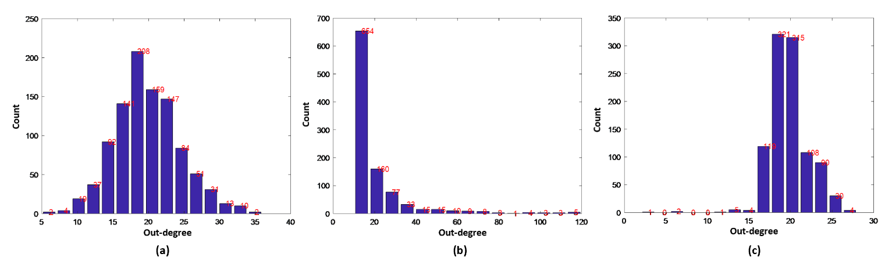
3. Results
3.1 Network buildup
Network types | (a) Erdős–Rényi Network | (b) Scale-free Network | (c) Small-world Network
Actual out-degree | 19.86 | 19.64 | 19.86
Structure entropy | 4.15 | 4.55 | 3.22

Slide 5
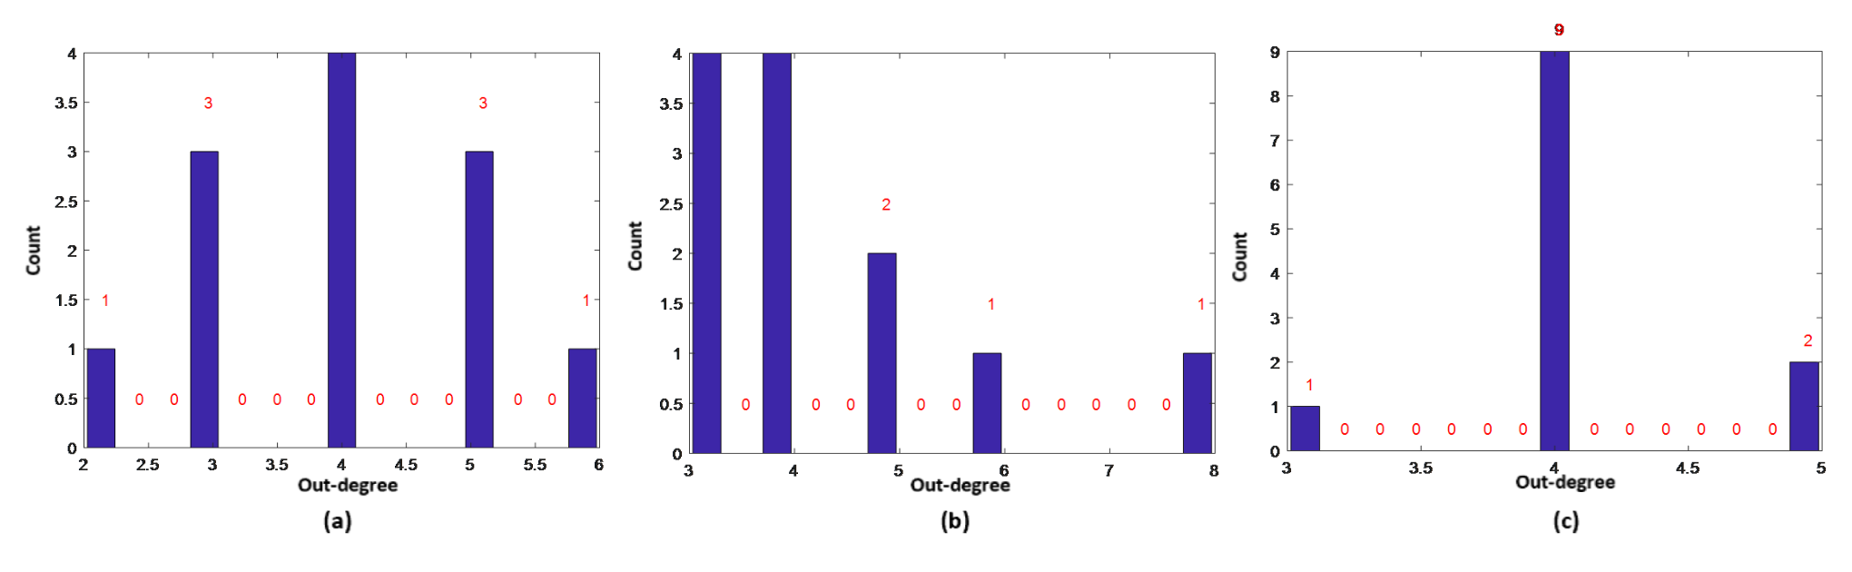
3. Results
3.2 Influence of resources on network resilience
12-node
network
Network types | (a) Erdős–Rényi Network | (b) Scale-free Network | (c) Small-world Network
Actual out-degree | 4.00 | 4.33 | 4.08
Structure entropy | 2.13 | 2.09 | 1.04

Slide 6
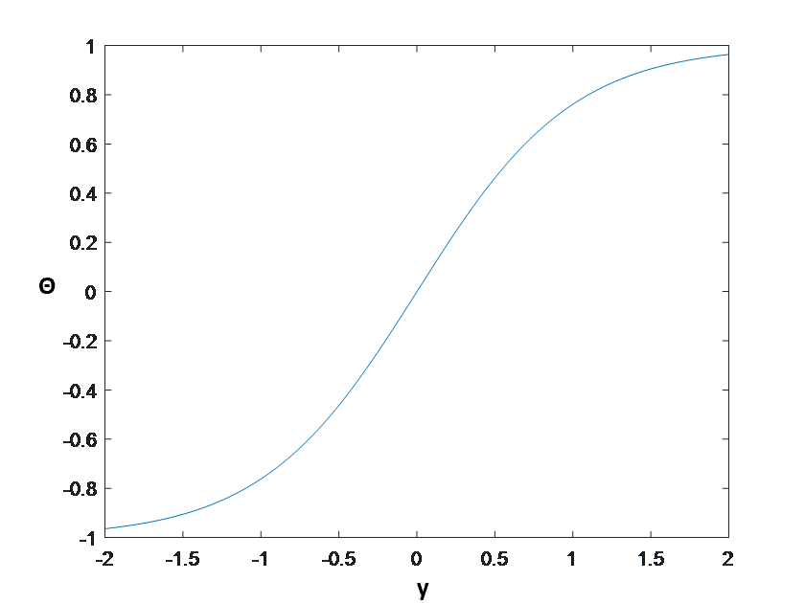
3. Results
3. Results
3.2 Influence of resources on network resilience
External stimulation
a₁=100, b₁=3, c₁=2
T=0.1:0.1:4
Figure. Sigmoidal function curve

Slide 7
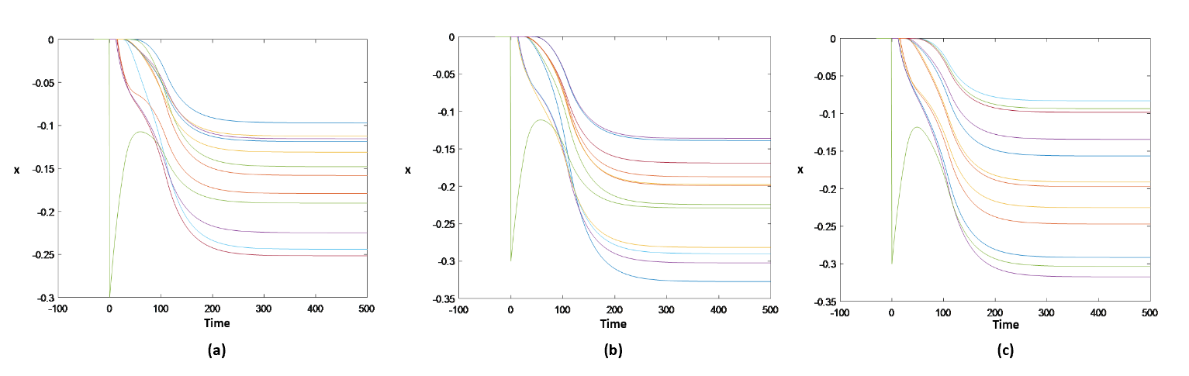
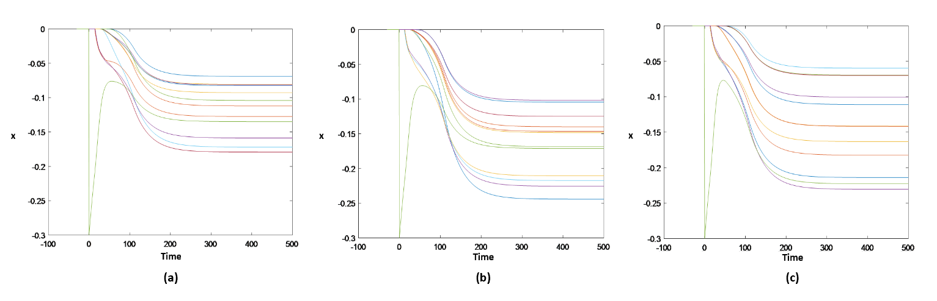
3. Results
3.2 Influence of resources on network resilience
Without stimulation
With
stimulation

Slide 8
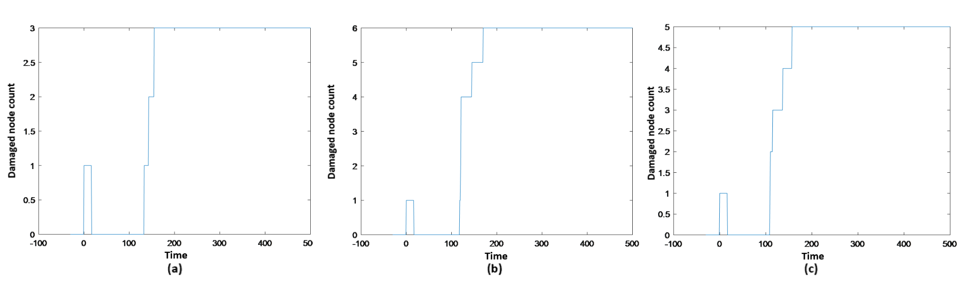
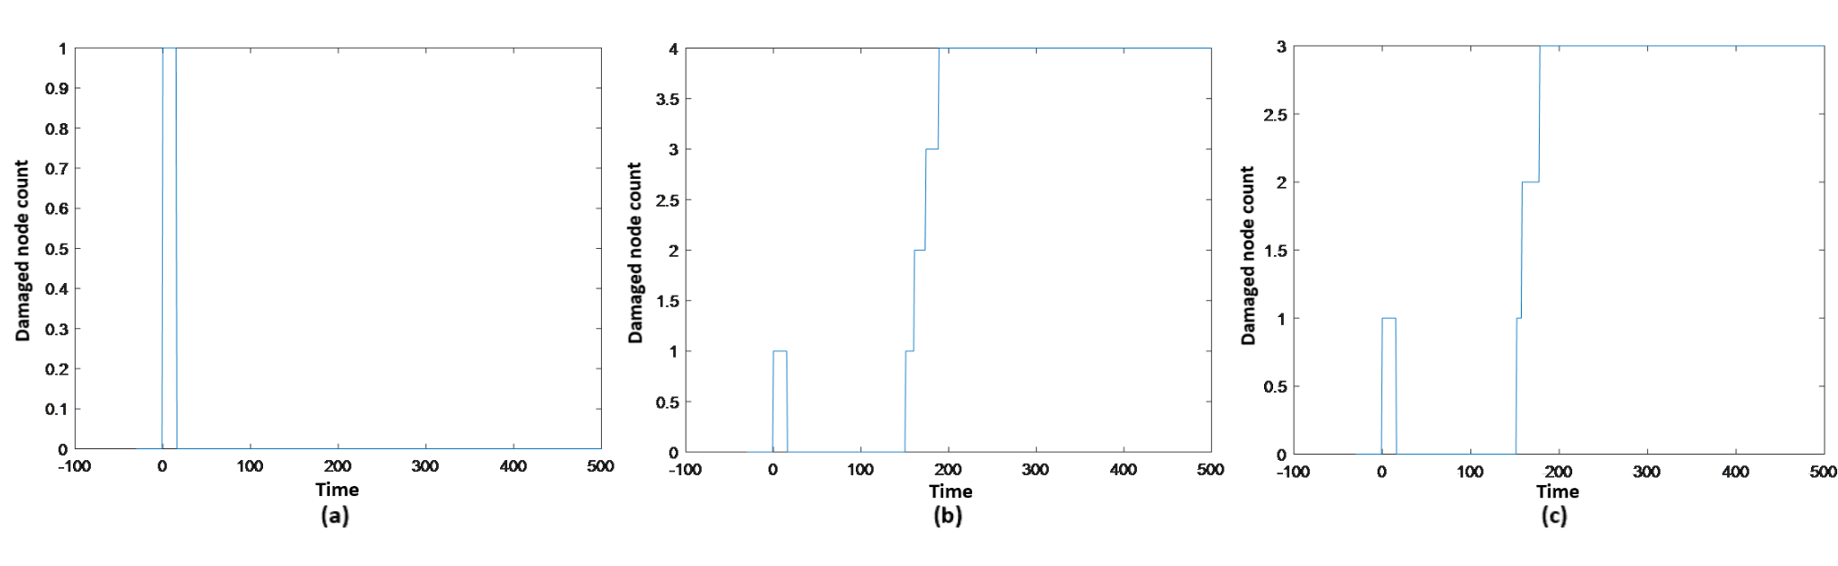
3. Results
3.2 Influence of resources on network resilience
Without stimulation
With
stimulation

Slide 9
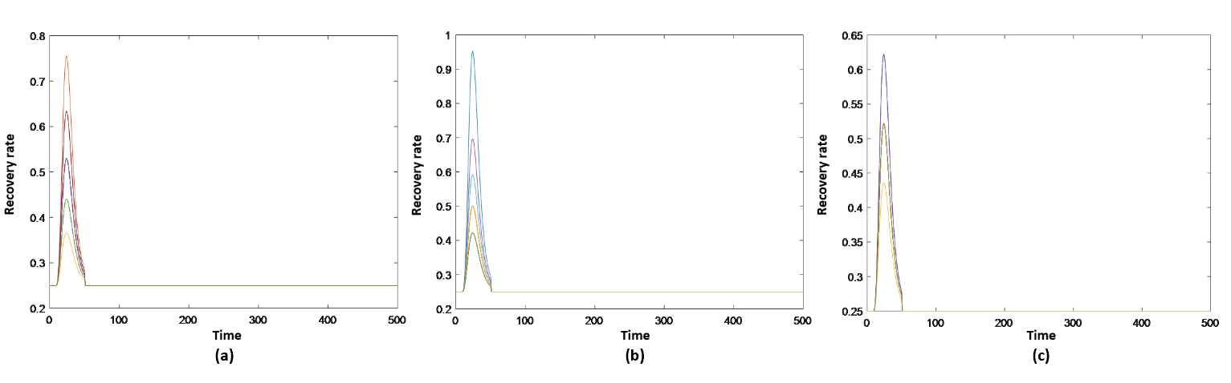
3. Results
3.2 Influence of resources on network resilience
Figure. Recovery rate vs. time in scenario with stimulation of (a) Erdős–Rényi network, (b) scale-free network and (c) small-world network

Slide 10
3. Results
3.3 Case study – Free scale network
Table 3. Out-degree of 8 companies in Wanda Group
Company | Rental | Real estate | Film | Sports | Finance | Internet technology | Culture | Baobeiwang
Out-degree | 2 | 5 | 4 | 3 | 3 | 2 | 2 | 1

Slide 11
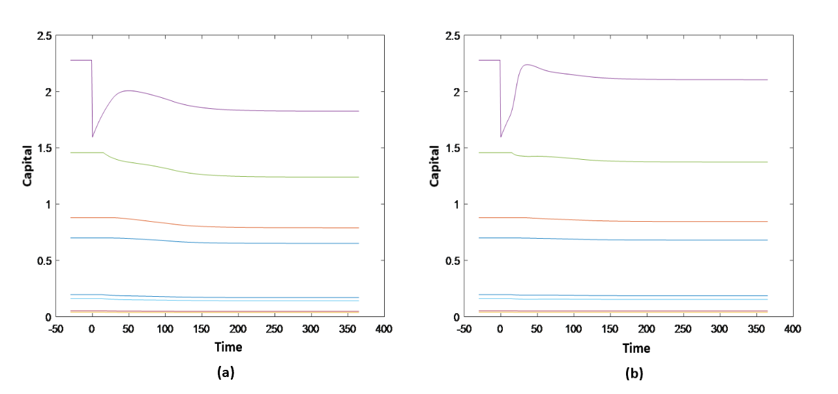
3. Results
3.3 Case study – Free scale network
Without stimulation
With stimulation

Slide 12
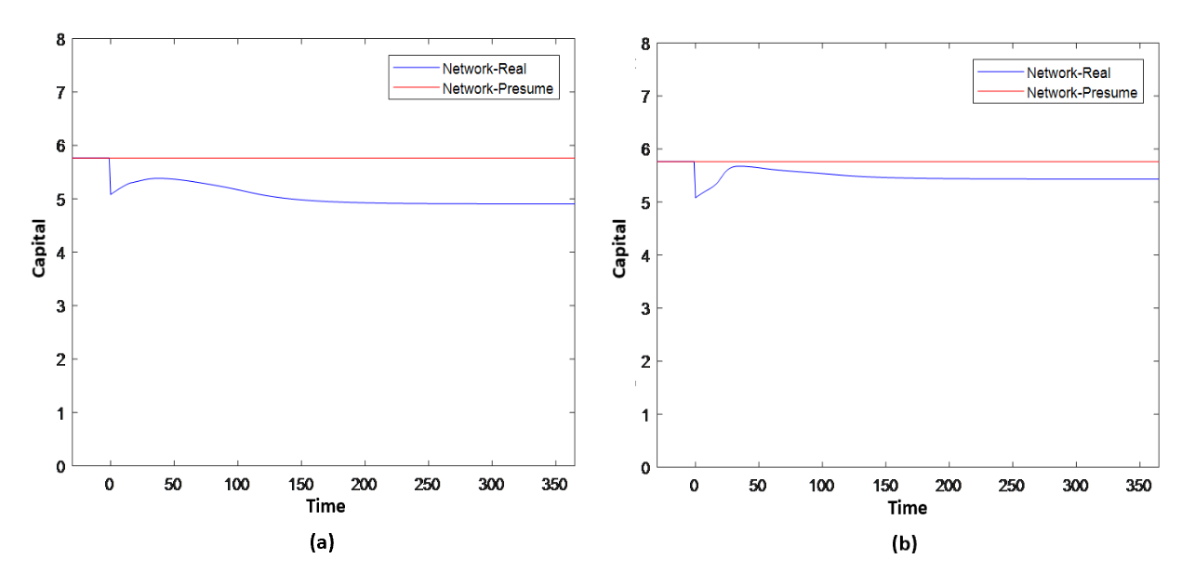
3. Results
3.3 Case study – Free scale network
Without stimulation
With stimulation

Slide 13
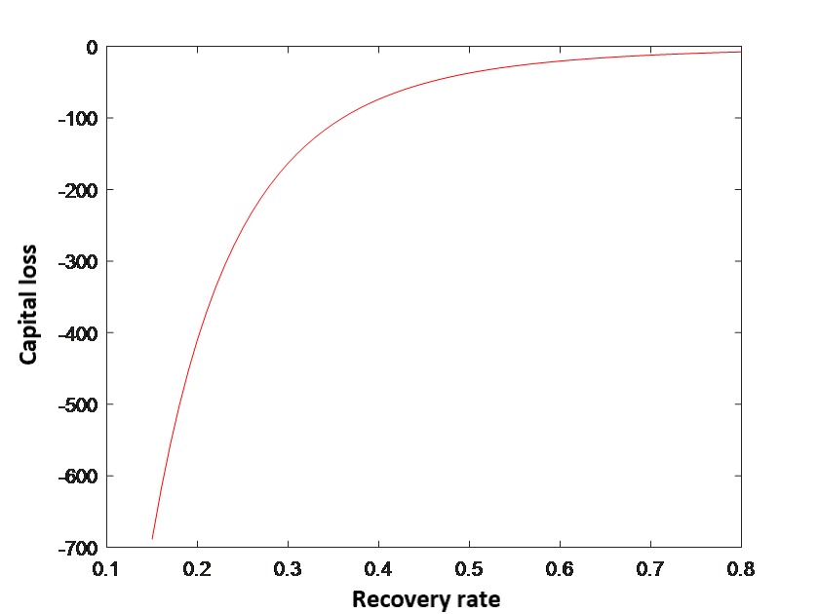
3. Results
3.3 Case study – Free scale network

Slide 14
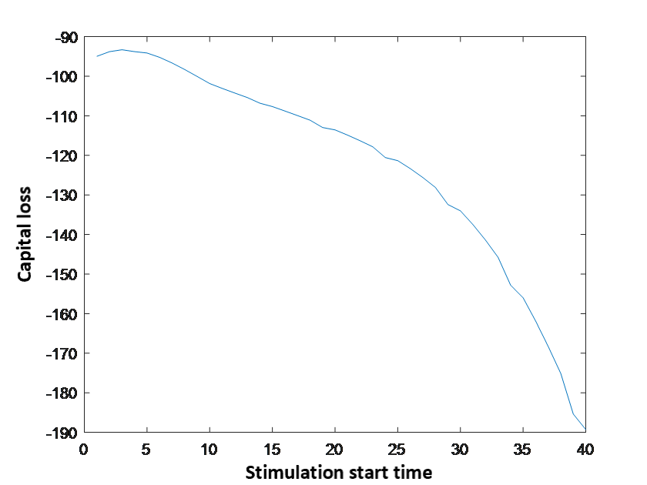
3. Results
3.3 Case study – Free scale network

Slide 15
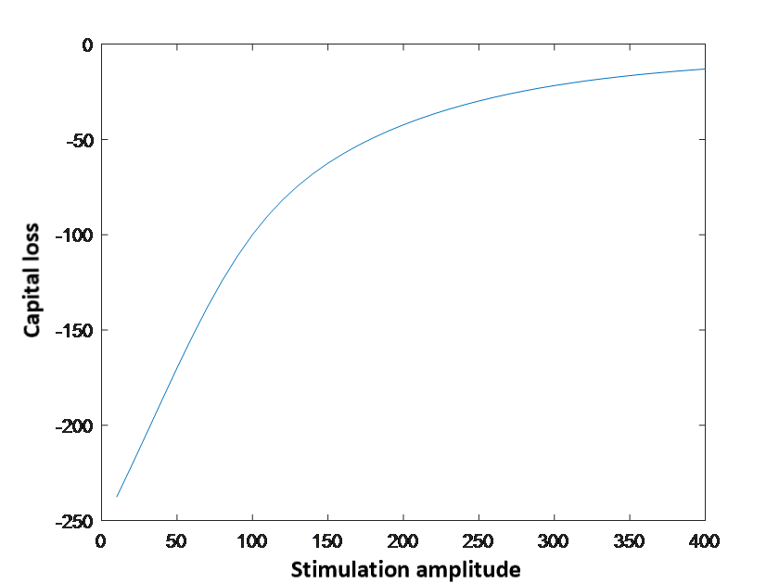
3. Results
3.3 Case study – Free scale network

Slide 16
3. Results
3.3 Case study – Free scale network
→ A best strategy considering both the cost of resources input and the capital loss prevention.

Slide 17
4. Conclusion
Each action can invoke a variety of unpredictable reactions.
Every node is influenced by the disruption occurred in the selected node.
The number of points that stay in the incurable damage level decrease when external incentives are inserted.
Optimized effect.
Notes:
External financial disruption and the operation of inter-connected infrastructures involve an intricate decision making where each action can invoke a variety of unpredictable reactions.
Under the condition that no external incentive is made, every node is influenced by the disruption occurred in the selected node. Then an implementation of the vulnerability and resilience concept with the adaptations of the operating estimations of subsidiaries within Wanda Group is performed.
When the responses time delay and distribution of resources are limited in reasonable ranges, the threshold point in simulation time has the optimized effect.

Slide 18
Literature
[1] Mattila A S. The effectiveness of service recovery in a multi-industry setting[J]. Journal of Services Marketing, 2001, 15(7): 583-596.
[2] Mirchev D E M J. ON THE SPECTRA OF SCALE-FREE AND SMALL-WORLD NETWORKS СПЕКТРАЛЕН АНАЛИЗ НА SCALE-FREE И SMALL-WORLD МРЕЖИ[J].
[3] Kim Y, Chen Y S, Linderman K. Supply network disruption and resilience: A network structural perspective[J]. Journal of operations Management, 2015, 33: 43-59.
[4] Buzna, Lubos, et al. "Efficient response to cascading disaster spreading." Physical Review E 75.5 (2007): 056107.
[5] Erdos, Paul, and Alfréd Rényi. "On the evolution of random graphs." Publ. Math. Inst. Hung. Acad. Sci 5.1 (1960): 17-60.
[6] Barabási, Albert-László, and Réka Albert. "Emergence of scaling in random networks." science 286.5439 (1999): 509-512.
[7] Watts, Duncan J., and Steven H. Strogatz. "Collective dynamics of ‘small-world’networks." nature 393.6684 (1998): 440.

Slide 19

Thanks for your attention !
Q&A

